Slide 2
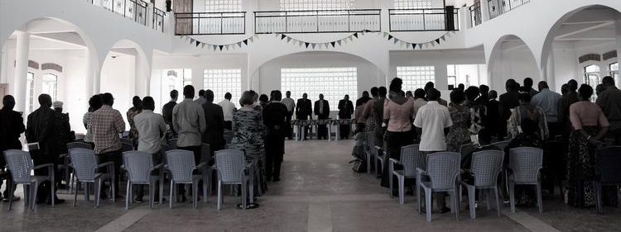
Sanga
Sanga Pastors’
Conference
Presenter, Phil Morrison

Slide 3

Child Safety in the Church: Session Two

Slide 4
Creating a Safe Place for our Children

Slide 5
What does a safe place look like?

Slide 6
What would be the safest space for a child?

Slide 7
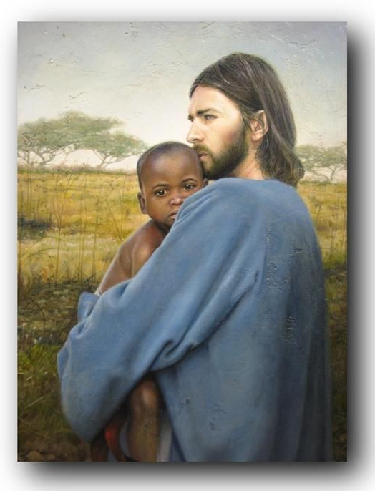
The lap of Jesus!
Look at
Mark 10:13-16

Slide 8
The lap of Jesus was safe because it was a place of protection.

Slide 9
Have we made our churches, our congregations, and our schools places of protection from child abuse, for our children?

Slide 10
The lap of Jesus was safe because it was a place of acceptance.

Slide 11
Are our churches welcoming and accepting of children?

Slide 12
The lap of Jesus was safe because it was a place of affirmation.

Slide 13
Are our churches and schools safe places that affirm the value and worth of our children?

Slide 14
The lap of Jesus was safe because it was a place of blessing.

Slide 15
Are our churches safe places where children receive a blessing and are blessed by our intentional watch care for their protection?

Slide 16
Policies and Procedures

Slide 17
The Goal of Policies and Procedures

Slide 18
To implement Child Safety Prevention Principles:

Slide 19
⬆
Increase Accountability
⬇
Decrease Isolation
⬅➔
Balance of Power

Slide 20
The Value of Policies and Procedures

Slide 21
They are educational

Slide 22
They are protective

Slide 23
They give guidance

Slide 24
They may soon be required

Slide 25
The Republic of Kenya, “County Child Protection Systems Guideline” states:

Slide 26
Organizations providing services to children shall prove their commitment to upholding child protection standards by developing child protection policies…

Slide 27
All staff, whether in direct or indirect contact with children… shall sign a statement of commitment to child protection as part of their employment contracts…

Slide 28
These shall include police officers, teachers, doctors and nurses, all other state and non-state actors (NGOs, CBOs, faith communities) coming into contact
with children in the
line of their duty.

Slide 29
In Tanzania UNICEF is working to develop similar laws

Slide 30
They are working closely with the government on
“the development and implementation of a National Plan of Action to Prevent and Respond to Violence against Children, involving the police, justice system, health and social welfare services, HIV/AIDS sector, education and civil society…

Slide 31
…This multisector plan reflects work that is ongoing to strengthen child protection systems and seeks to support and expand upon existing national efforts to prevent and respond to all forms of violence, abuse and exploitation against children.”
Child Protection, https://www.unicef.org/ tanzania/ChildProtection_factsheet.pdf

Slide 32
…This multisector plan reflects work that is ongoing to strengthen child protection systems and seeks to support and expand upon existing national efforts to prevent and respond to all forms of violence, abuse and exploitation against children.”
Child Protection, https://www.unicef.org/ tanzania/ChildProtection_factsheet.pdf

Slide 33
So for the safety of our children and compliance with the regulations that may be coming let us, in our denomination and in our local churches, put in place policies and procedures as soon as possible.

Slide 34

A Sample Policy

Slide 35
Definitions

Slide 36
According to WHO and Tanzanian Law: 18years and under.

Slide 37
Definition of Child Sexual Abuse
“Child sexual abuse is the involvement of a child in sexual activity that he or she does not fully comprehend, is unable to give informed consent to, or for which the child is not developmentally prepared and cannot give consent, or that violates the laws or social taboos of society…

Slide 38
Definition of Child Sexual Abuse
Child sexual abuse is evidenced by this activity between a child and an adult or another child who by age or development is in a relationship of responsibility, trust or power, the activity being intended to gratify or satisfy the needs of the other person.

Slide 39
Definition of Child Sexual Abuse
This may include but is not limited to: the inducement or coercion of a child to engage in any unlawful sexual activity; the exploitative use of a child in prostitution or other unlawful sexual practices; the exploitative use of children in pornographic performance and materials.”

Slide 40
Definition of Child Sexual Abuse
World Health Organization, 2003, “Guidelines for medico-legal care for victims of sexual violence,”
Accessed January 5, 2015. http://whqlibdoc.who.int/publications/2004/924154628x.pdf.

Slide 41
Definition of a Worker
The term “worker” would include anyone involved in a church ministry (Sunday School, Vacation Bible School, Church camps, etc.), a church sponsored school, in overnight activities involving minors, in counselling of minors, or in one-on-one mentoring of minors.

Slide 42
Workers:
Requirements

Slide 43
Requirements for Teachers:
Must be a member as the local church defines it.
Must be born again and evidencing Christian growth and maturity.
Must regularly attend worship services and church events and not only be involved in the Children’s Ministry functions.

Slide 44
Requirements for Assistants:
A non-member, as the local church defines it, may be an assistant worker.
Must be a person who is born again and evidencing Christian growth and maturity.
Must regularly attend worship services and church events and not only be involved in the Children’s Ministry functions.

Slide 45
Requirements for Workers:
Six Month Rule. No person will be considered for any ministry position involving contact with minors until she/he has been involved with the church for a minimum of six (6) months.

Slide 46
Requirements for Workers:
This is a time of pre-qualification which provides opportunity for interaction between our leadership and the applicant allowing for better evaluation and suitability of the applicant for working with children.

Slide 47
Age Requirements
All teachers must be at least 18 years of age.

Slide 48
Probationary Requirements
All new teachers and assistants (both adult and teenage) will go through a probationary period of four months under the supervision of an approved teacher.

Slide 49
Workers:
Screening

Slide 50
Workers:
Screening
All persons who desire to work with the children participating in our programs and activities will be screened.

Slide 51
Written Application
All persons seeking to work with children must complete and sign a written application. The application will request basic information from the applicant and will inquire into previous experience with children, if any, previous church affiliation, reference and employment information.

Slide 52
Written Application
All applicants shall sign a self-disclosure form confirming they have not previously been convicted for any offence involving any type of harm to a child or children, and declare anything that may affect their suitability to work with children.

Slide 53
Reference Checks
Before an interview at least two of the applicant’s references will be checked. These references should from an institution as opposed to personal or family references.

Slide 54
Reference Checks
Preferably, references should be from organizations where the applicant has worked with children in the past. One should be from the applicant’s former pastor.

Slide 55
Personal Interview
Upon completion of the application, a face-to-face interview may be scheduled with the applicant to discuss his/her suitability for the position.

Slide 56
Workers:
Teenagers

Slide 57
There may be times when it is necessary or desirable for child ministry workers, who are themselves under age 18, to assist in caring for children during programmes or activities.

Slide 58
The following guidelines apply to teenage class assistant workers:
Must be at least age 14.
Must be screened as specified above.
Must be under the supervision of an adult and must never be left alone with children.

Slide 59
Adult Oversight Guidelines (AOGs)

Slide 60
1. Two Adult Rule
The goal is to have a minimum of two unrelated adult workers in attendance at all times when children are being supervised during our programmes and activities.

Slide 61
Some youth classes may have only one adult teacher in attendance during the class session; in these instances, doors to the classroom should remain open and there should be no fewer than three students with the adult teacher.

Slide 62
Minors are not to be left alone with one adult on the premises or in any sponsored activity unless in a counselling situation.

Slide 63
2. Mixed Male-Female Groups Where there are mixed male-female groups there must be male and female leaders. In case where, for example
there is a girls’ group with a male facilitator/leader, there must also be a female facilitator/leader present.

Slide 64
3. Visible Ministry Policies
No workers are ever to be alone with a child. At least two workers should be present whenever possible.
If a child arrives early, keep the door open and remain visible.
Doors without a glass pane installed should never be closed completely when children are inside with adults.
When holding a private talk with a student, especially of the opposite sex, be sure to sit in view of an open door or window.

Slide 65
4. Toilet Facilities Policies
Our church will seek, as possible, to provide or reserve separate toilet facilities for males and females. As much as possible separate facilities will be provided for boys and girls.

Slide 66
4. Toilet Facilities Policies
For children under five years old, workers should escort a group of children to the toilet. They should always go in a group, never taking a child alone. The workers should check the toilet first to make sure that it is vacant, and then allow the children inside.

Slide 67
4. Toilet Facilities Policies
The workers should remain outside and then escort the children back to the classroom. If a child is taking longer than seems necessary, the worker should call the child to see if assistance is needed.

Slide 68
4. Toilet Facilities Policies
For the protection of all, workers should never be alone with a child in a toilet with the door closed. If a child requires assistance, the workers should always leave the door open far enough that other workers can see in. Do not allow the children to “watch” while another child is using the toilet.

Slide 69
4. Toilet Facilities Policies
For children over the age of five, at least one adult male should take boys to the toilet and at least one adult female should take girls. The worker should check to make sure that the toilet is vacant, and then allow the children inside. The worker should then remain outside the toilet door and escort the children back to the classroom.

Slide 70
Code of Conduct

Slide 71
Code of Conduct
Workers involved in children’s ministry agree not to:
Engage in inappropriately rough physical play with a child or young person (not their own).
Use physical means or corporal punishment to discipline or control a child, other than reasonable restraint such as by holding a child to minimize injury.

Slide 72
Code of Conduct
Hold, kiss, cuddle, or touch a child (not their own) in an age/culturally inappropriate manner OR in a manner considered inappropriate by reason of the nature of the program/activity/ occasion/event, except for appropriate touch (for example to comfort distress).

Slide 73
Responses to Allegations of Child Sexual Abuse

Slide 74
If a worker involved in the care of children becomes aware of suspected sexual abuse of a child under his/her care, this should be reported immediately to the designated person for further action, including reporting to authorities as may be mandated by state law. This verbal report should be accompanied by a written Abuse Incident Report. (See Appendix B.)

Slide 75
If an incident of child sexual abuse is alleged to have occurred at our church sponsored programs or activities, the following procedure shall be followed:
1. The parent or guardian of the child will be notified.

Slide 76
2. The worker or church member alleged to be the perpetrator of the abuse must immediately cease involvement in ministry pending an investi-gation and instructed to remain away from the premises during the investigation. He or she should be instructed to have no contact with the victim or with witnesses.

Slide 77
3. Our church commits to report allegations of abuse to the civil authorities and to fully cooperate with their investigation of the incident.

Slide 78
4. Our church must designate a spokesperson to the media concerning incidents of abuse or neglect. The advice of legal counsel will be sought before responding to media inquiries or releasing information about the situation to the congregation. All other representatives of our church should refrain from speaking to the media.

Slide 79
5. A pastoral visit will be arranged for those families who desire it. This should be for the purpose of providing pastoral support during the time of crisis and not for the purpose of investigating the incident or influencing the investigation.

Slide 80
6. Any person who is found guilty of the alleged abuse or misconduct must be removed from their position working with children or youth. At this point the perpetrator will be turned over to the governing authorities so that the legal process may take its course.

Slide 81
Responses to Victims of Child Sexual Abuse

Slide 82
Our church commits to the following pastoral care ministry for the family and victims of child sexual abuse who experienced the abuse while involved in an official ministry of the church:

Slide 83
Providing a medical examination and treatment for the victim
Pastoral and professional counselling for the victim and his or her family.
Legal counsel and advice for the victim and the family.
Financial support for the above pastoral care ministries.

Slide 84
Training

Slide 85
Our church will provide training on this child protection policy to the following:
1. All church leaders. They will go through training on this policy and its requirements regardless whether they are involved in children’s ministry or not.

Slide 86
2. All new childcare workers. In addition, our church will strive to provide opportunities for additional training classes or events on an annual basis. All workers are strongly encouraged to attend these training events.

Slide 87
3. To all parents of children who attend the various children’s ministries of the church.
4. To all children who attend the various children’s ministries of the church.
5. Training will be done in an age appropriate and culturally sensitive manner.

Slide 88
Forms

Slide 89
Appendix A
Children’s Ministry Application Form
Appendix B
Abuse Incident Report

Slide 90
Questions?

Slide 91
safe places for our children!
May God help us to make our churches

