Slide 1
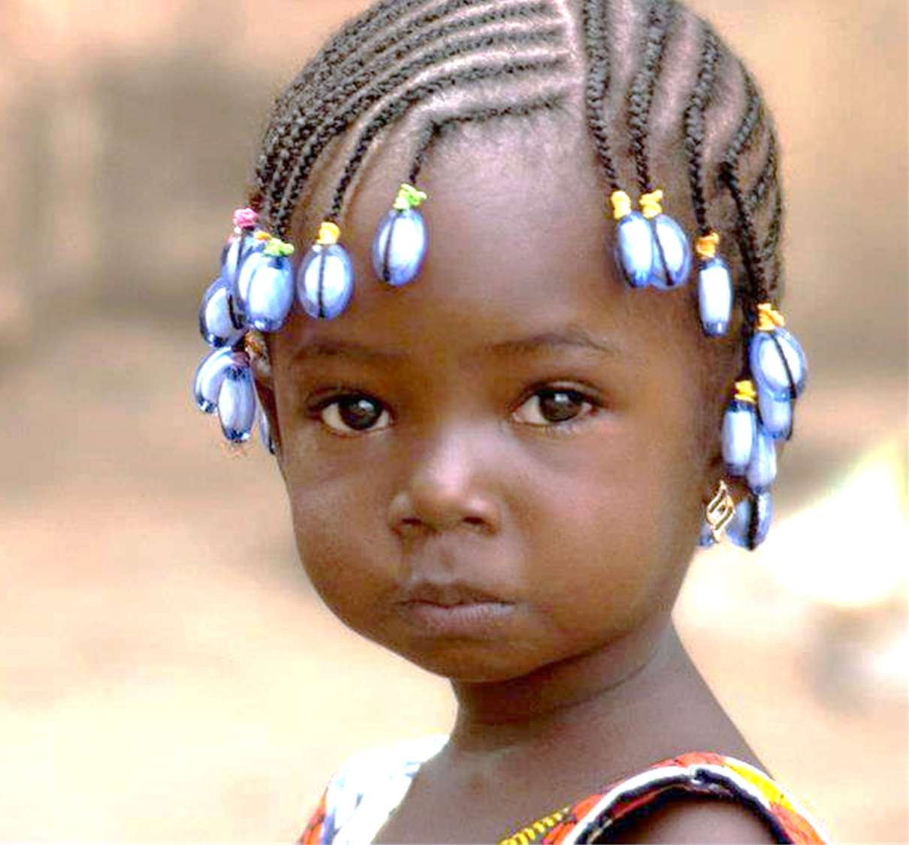
2018 Pastors’ Conference Sanga Sanga

Slide 2
Child Safety in the Church

Slide 3
One pastor’s story…
Notes:
Tell Pastor’s story whose daughter was sexually abused. He said that he wasn’t getting much help from the police but he was still pursuing the case. He happened to be a regional leader in his denomination and he said, as a result of this study he was going to be implementing training in his churches.

Slide 4
We are in a battle!

Slide 5
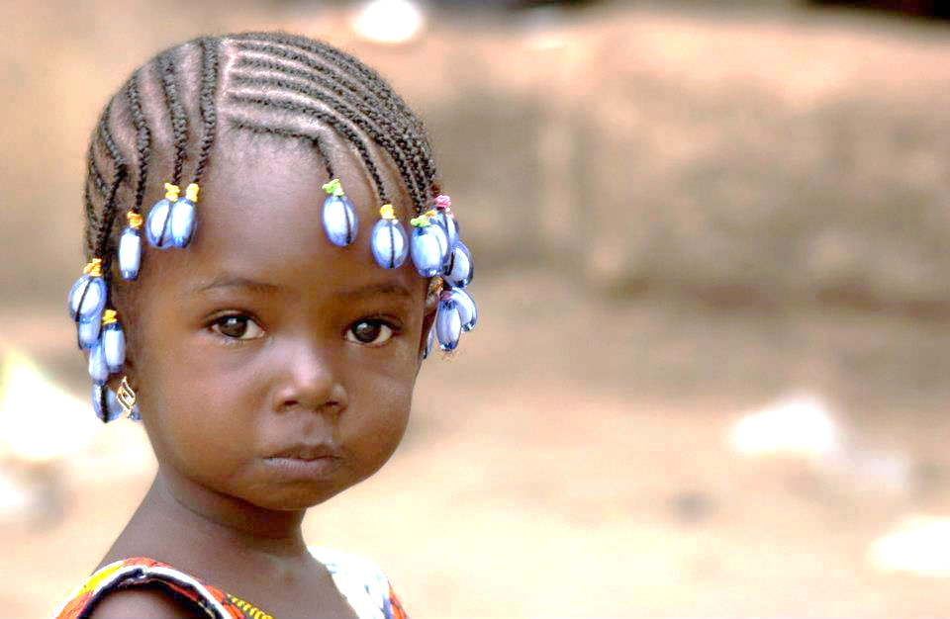
Presence of CSA: General statistics.

Slide 6
Kenya~ Girls: 32% Boys: 18%

Slide 7
Tanzania~ Girls: 30% Boys: 14%

Slide 8
Presence of CSA in the church.

Slide 9
In the American context, “Studies and statistics today…indicate an incidence of abuse within the church equal to that in the general population.” Beth Swagman, Preventing Child Abuse, (Grand Rapids, Michigan: Faith Alive Christian Resources, 2003), 5.

Slide 10
78.1% reported

Slide 11
Over 227 incidents

Slide 12
Church Offenders:

Slide 13
Church Offenders: Pastors: 32.9%

Slide 14
Church Offenders: Pastors: 32.9% Leaders: 21.9%

Slide 15
Church Offenders: Pastors: 32.9% Leaders: 21.9% S.S. teacher: 4.9%

Slide 16
Church Offenders: Total: 59.5% just in the leadership!

Slide 17
What can be done?

Slide 18
Instruction
Notes:
Tell Pastor’s story whose daughter was sexually abused. He said that he wasn’t getting much help from the police but he was still pursuing the case.

Slide 19
Biblical view of children
Cultural view of children
vs.

Slide 20
The professed cultural view of children

Slide 21
“The child occupies a unique and privileged position in the African society.” African Charter on the Rights and Welfare of the Child

Slide 22
“…the inherent dignity of the child.” The African Charter on the Rights and Welfare of the Child mentions Article 20 (c)

Slide 23
Thoko Kaime: Children are a valuable part of the society.… [and] must be well protected and nurtured otherwise without them, society will die.

Slide 24
“African children suffer a lot from harmful cultural practices and notions which enjoy more legitimacy than international children’s rights norms.”

Slide 25
“The purpose of the many rules in the charter…does not protect the African child since child rights abuses such as defilement, corporal punishment, child trafficking, and child labour are on the ascendency throughout Africa.” –Charles Ohene–Amoh

Slide 26
The practiced
cultural view:

Slide 27
Children are a man’s property.

Slide 28
The National Director of the South African National Council for Child Welfare said, “the most fundamental [root problem] was how… children are being viewed: that children were a commodity.”

Slide 29
“Cultural values that encourage treating children as possessions pose no barrier to use of children to satisfy adult sexual desires.” -Linda Richter

Slide 30
Children are inferior

Slide 31
“Some men see children as inferior human beings who can be sexually abused at will. …

Slide 32
[M]en—regardless of racial and ethnic background—have so many privileges that they feel they have the right to do whatever they want, including sexually abusing children.”-Hassan O. Kaya

Slide 33
A inferiority hierarchy

Slide 34
Boys
Girls

Slide 35
57. Issue: Gender discrimination in Children
“Due to different Tanzanian cultures and customs, parents and guardians usually value boy children more as compared to girl children, which leads to girl children at times to be denied their basic rights, and consequently having relatively poor development….

Slide 36
For example, boys are always preferred over girls, in schooling issues, they are always given the chance to play, rest and the right to recreation while girls are necessitated to help their mothers with domestic chores.”
The Tanzania Ministry of Community Development, Gender And Children, Child Development Policy , p. 22-23.

Slide 37
Boys
Girls
Disabled (boys-girls)

Slide 38
“Half of the children with disabilities reported abuse at 1-3 times a week – this is more often than any other category of children.” -The African Report on Violence Against Children

Slide 39
“Girls with disabilities are…at higher risk of abuse and violence, which in turn can aggravate existing disabilities or create secondary disabilities such as psychosocial trauma.” -The African Report on Children with Disabilities

Slide 40
Boys
Girls
Disabled (boys-girls)
Albinos

Slide 41
“Children with albinism in Africa are sometimes seen as not fully human, and may suffer severe discrimination. They are sometimes known as ‘children of the moon.’ In Tanzania, [they] are referred to as…ghosts. In South Africa,…as apes.” -The African Report on Violence Against Children

Slide 42
Thus, we see a disparity between what is stated in many African cultures of the value and worth of the child and what is actually practiced.

Slide 43
This low view of the value and worth of children is therefore a contributing factor which can result in sexual abuse with impunity.

Slide 44
A biblical view of children

Slide 45
Children are God’s image bearers.
Genesis 1:26

Slide 46
“The notion that children are fully human and made in the image of God has often been neglected in Christianity, and children have been referred to as “animals,” “beasts,” pre-rational,” “pre-adults,” “almost human,” “not quite human,” or “on their way to becoming human.”” Marcia J. Bunge

Slide 47
Children are God’s handiwork.
Psalm 139:13-15

Slide 48
Children are ranked a little lower than angels.
Psalm 8:5

Slide 49
Children are a blessing from God.
Psalm 127:3-5

Slide 50
^{“3}Children are a heritage from the Lord, offspring a reward from him... ⁵ Blessed is the man whose quiver is full of them.” -Psalm 127:3, 5

Slide 51
Jesus held a high view of a child’s value and worth
Matthew 18:1-7

Slide 52
The seriousness with which Jesus views the harming of children and causing them to be led astray demonstrates the high value and worth that he places on the child.

Slide 53
We take care of that which we value.

Slide 54
Is the African church taking care of its children? If not, do we really value them?

Slide 55
Involvement

Slide 56
“The sin of respectable people reveals itself in flight from responsibility.” Eberhard Bethge, friend of Dietrich Bonhoeffer.
Notes:
As quoted in the introduction of Dietrich Bonhoeffer, Life Together. (New York: Harper & Brothers, 1954), 11.

Slide 57
A theology of intervention

Slide 58
The Biblical Basis:

Slide 59
1. Micah 6:8: “And what does the Lord require of you? To act justly and to love mercy and to walk humbly with your God.”

Slide 60
2. Isaiah 58:9: “Is not this the kind of fasting I have chosen: to loose the chains of injustice and untie the cords of the yoke, to set the oppressed free and break every yoke?”

Slide 61
“In the widest sense, it means ‘to put things right’, to intervene in a situation that is wrong, oppressive, or out of control, and to fix it.” -Chris Wright

Slide 62
3. Job 29:17: I broke the fangs of the wicked and snatched the victims from their teeth.

Slide 63
“To break the fangs of an animal is to disable it so that it is largely defenceless and unable to capture its victim.” -William Reyburn:

Slide 64
Therefore, Job is saying he not only rescued the oppressed, but he also disabled the oppressor so he could not continue his crimes.

Slide 65
Preventing continuing predation upon old and new victims must be one of the main purposes of the church’s intervention.

Slide 66
“One has to decide where lie the greatest injustices and where lie the greatest vulnerability. Other things being equal, one focuses one’s attention on those.” Nicholas Wolterstorff.
Notes:
As quoted by Tim Keller, Generous Justice. (London: Hodder & Stoughton Ltd., 2010), 8.

Slide 67
Initiating Action

Slide 68
Proactive Interventions

Slide 69
Prophetically address the culture’s view of the value and worth of children.

Slide 70
Rescue children who are being sexually abused.

Slide 71
“This is what the Lord says: ‘Do what is just and right. Rescue from the hand of the oppressor the one who has been robbed.’” (Jer. 22:3a).

Slide 72
Speak up for the victims of abuse. Proverbs 31:8-9

Slide 73
“⁸Speak up for those who cannot speak for themselves, for the rights of all who are destitute. ⁹ Speak up and judge fairly; defend the rights of the poor and needy.”

Slide 74
Defend those who suffer from abuse or are at risk of being abused.

Slide 75
How do we defend?

Slide 76
Shelter victims from public ridicule and shame.

Slide 77
Keep identities of the abused and details of the abuse as private as possible.

Slide 78
Administer justice for both the victim and perpetrator.

Slide 79
Walter Brueggemann sees justice “as a positive and aggressive action … it is active intervention to transform society. And that transformation, on the one hand, means to act favourably toward the weak and, on the other hand, effectively against the abusive wrong.”

Slide 80
It is only by bringing the perpetrator to justice that justice can be gained for the victim.

Slide 81
If the church does not report perpetrators to the authorities, they are covering up a crime and thus become part of the crime themselves.

Slide 82
Unfortunately, the church does not always do well when providing justice against the perpetrator of child sexual abuse.

Slide 83
Actions taken against the perpetrator

Slide 84
Turned over to civil authorities 66.3%

Slide 85
“The legal system does not handle cases of CSA with sufficient care. For example, paying a small fee to the family of the victim settles the problem in the short term but the perpetrator is free to continue abusing other children. In addition, in cases that do make it to court, the child is treated like an adult.” McCrann, 233.

Slide 86
Church Discipline: 53.4%

Slide 87
Transferred: 11.7%

Slide 88
Nothing! 17%

Slide 89
Note: Interventions will be costly.

Slide 90
In Isaiah 58:7 God’s people are enjoined to, “share your food with the hungry and to provide the poor wanderer with shelter—when you see the naked, to clothe them…”

Slide 91
James 2:15-16 says, “Suppose a brother or sister is without clothes and daily food. ¹⁶If one of you says to him, ‘Go, I wish you well; keep warm and well fed,’ but does nothing about his physical needs, what good is it?”

Slide 92
“Save us and help us with your right hand, that those you love may be delivered.” Ps. 60:5

Slide 93
Questions?

