Slide 1
Sanga Sanga Pastors’ Conference
Presenter, Phil Morrison

Slide 2
Is this your team?

Slide 3
Why, if we are brothers and sisters in Christ, do we need to look at the disfunctions of a team?

Slide 4
“The fact remains that teams, because they are made up of imperfect human beings, are inherently disfunctional.”
-Patrick Lencioni

Slide 5
The Five
Disfunctions
of a Team
Adapted from Patrick Lencioni’s book of the same name

Slide 6
The Five Disfunctions of a Team
Absence of trust

Slide 7
1
“The first disfunction is an absence of trust among team members. Essentially, this stems from their unwillingness to be vulnerable within the group. Team members who are not genuinely open with one another about their mistakes and weaknesses make it impossible to build a foundation for trust."
Patrick Lencioni, The Five Dysfunctions of a Team, (San Francisco: Jossey-Bass, 2002) p. 188.

Slide 8
The Five Disfunctions of a Team
Projection of Invulnerability
Absence of trust

Slide 9
1
We all know for certain that we have weaknesses!
But this can be a problem for “leaders who think in terms of presenting an image of ‘omnicompetence’.”
--Nancy Ortberg

Slide 10
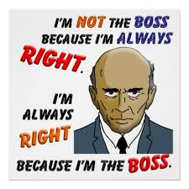
1

Slide 11
1
We may not claim “omnicompetence” but we simply excuse or ignore our faults which in practice is a projection of invulnerability!

Slide 12
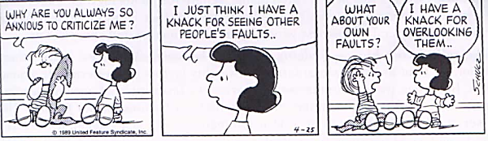
1

Slide 13
1
Lencioni writes:
In the context of building a team, trust is the confidence among team members that their peers’ intentions are good, and that there is no reason to be protective or careful around the group. In essence, teammates must get comfortable being vulnerable with one another.
Lencioni, p. 195.

Slide 14
1
An Absence of Trust is most likely an Absence of Truth.*
(or more kindly or realistically, an absence of information.)
*https://www.youtube.com/watch?v=Uf6aAvsYGoM (accessed 23 February.)

Slide 15
The Five Disfunctions of a Team
Vulnerability
2 Cor. 12:9-10
Projection of Invulnerability
Absence of trust

Slide 16
⁹ But he said to me, “My grace is sufficient for you, for my power is made perfect in weakness.” Therefore I will boast all the more gladly about my weaknesses, so that Christ’s power may rest on me. ¹⁰ That is why, for Christ’s sake, I delight in weaknesses, in insults, in hardships, in persecutions, in difficulties. For when I am weak, then I am strong.
1
2 Corinthians 12:9-10

Slide 17
Vulnerability and Trust!

Slide 18
Neighbor

Slide 19
1. Je. Ukosefu wa kuaminika ‘Trust’ huonekana katika huduma yangu au timu yangu?
2. Je. Inawezekana kuwa na uwazi ‘openness’ na ‘vulnerability’ kati ya watu ambao wanaofanya kazi ofisini au kanisani kwangu?
3. Je, inatupasa kubadilisha nini ili kujenga hali ya kuaminika ‘trust’ zaidi katika timu au huduma zetu?
Neighbor

Slide 20
The Five Disfunctions of a Team
Fear of conflict
Vulnerability
2 Cor. 12:9-10
Projection of Invulnerability
Absence of trust

Slide 21
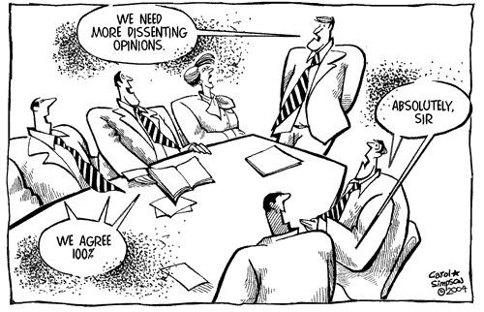
2

Slide 22
2
"This failure to build trust is damaging because it sets the tone for the second disfunction: fear of conflict. Teams that lack trust are incapable of engaging in unfiltered and passionate debate of ideas. Instead, they resort to veiled discussion and guarded comments."
Lencioni, p. 188.

Slide 23
2
Nancy Ortberg writes: “Of all the organizations with which I work, churches tend to be the worst at engaging fearlessly in conflict…When teams don’t engage in healthy, passionate, unfiltered debate around the most important issues, they inject more politics into the organization and make mediocre decisions guaranteed to deliver mediocre results.”

Slide 24
The Five Disfunctions of the Team
Artificial
Harmony
Fear of conflict
Vulnerability
2 Cor. 12:9-10
Projection of Invulnerability
Absence of trust

Slide 25
2
“One of the real dangers that small groups face is emphasizing consensus over dissent.”
James Surowiecki, The Wisdom of Crowds, p. 180.

Slide 26
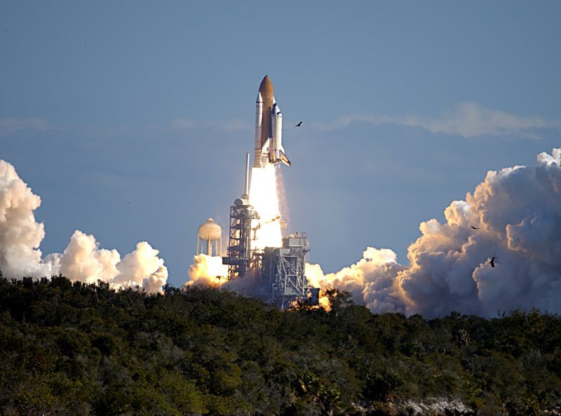
This was , “in part…because Ham (the team leader) was so obviously anxious for the problem to be resolved and so convinced that there was nothing to talk about.”
“What’s most striking about that…meeting is the utter absence of debate and minority opinions.”

Slide 27
2
This action contradicted
Peter Drucker’s first law of decision making:
“One does not make a decision without disagreements.”

Slide 28
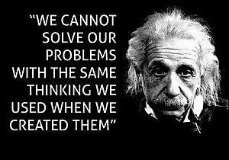
2

Slide 29
The Five Disfunctions of a Team
Authenticity
Artificial
Harmony
Fear of conflict
Vulnerability
2 Cor. 12:9-10
Projection of Invulnerability
Absence of trust

Slide 30
2
So how can authenticity be fostered on a team? It comes as a result of trust. And it comes with courage as we step out and practice it.

Slide 31
2
“Les and Leslie Parrott state ‘Conflict is the only way to intimacy.’ That’s a pretty startling statement with enormous implications in the context of teams. Our avoidance of conflict almost guarantees that we’ll fail to build relationally authentic teams. We’ll be unable to make the best decisions for the organization.”
-Ortberg.

Slide 32
2
“The confrontation with a dissenting view, logically enough, focuses the majority to interrogate its own positions more seriously.”
Surowiecki, p. 184.

Slide 33
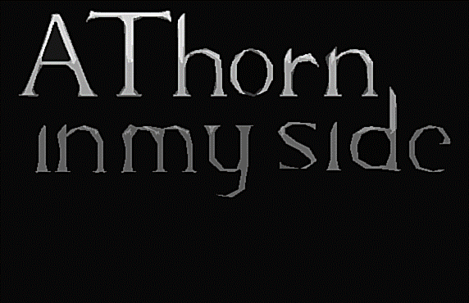

Slide 34
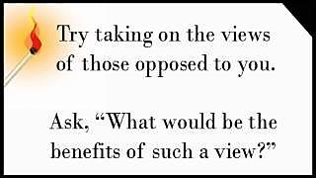
2

Slide 35
2
“Effective leaders encourage contrary opinions, an important source of vitality.”
Max De Pree, Leadership is an Art, p. 15.

Slide 36
2
Do we see an example of “helpful conflict” in Scripture? Can you think of an example?

Slide 37
The Five Disfunctions of a Team
Authenticity
Acts 15:1-7
Artificial
Harmony
Fear of conflict
Vulnerability
2 Cor. 12:9-10
Projection of Invulnerability
Absence of trust

Slide 38
2
Acts 15:1-7
Verse 7 says “after much discussion.”
I believe this was much healthy conflict as each party spelled out their positions.

Slide 39
2
*original word was “church”.
If we’re passionate about our [organization]*, we will fearlessly engage in conflict so that the [organization]* can resolve issues and move toward a shared vision. Conflict also enables us to “disagree and commit,” a phrase coined at Intel, but applicable to all teams.
(--Ortberg.)

Slide 40
Neighbor

Slide 41
1. Je kwa jinsi gani hofu ya migogoro inavyoonekana katika huduma yangu au timu yangu?
Kwa nini watu wanaogopa kutokubaliana na wanachama wengine wa timu na viongozi wao?
2. Je kuna mabadiliko gani tunaweza kufanya ili kukuza mgogoro mzuri katika huduma yetu au timu?
Neighbor

Slide 42
The Five Disfunctions of a Team
Lack of commitment
Authenticity
Acts 15:1-7
Artificial
Harmony
Fear of conflict
Vulnerability
2 Cor. 12:9-10
Projection of Invulnerability
Absence of trust

Slide 43
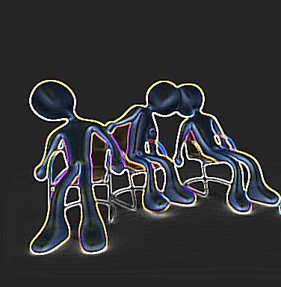
3
"A lack of healthy conflict is a problem because it ensures the third disfunction of a team: lack of commitment. Without having aired their opinions in the course of passionate and open debate, team members rarely, if ever, buy in and commit to decisions, though they may feign agreement during meetings.”
Lencioni, p. 188-189

Slide 44
The Five Disfunctions of a Team
Lack of commitment
Ambiguity
Authenticity
Acts 15:1-7
Artificial
Harmony
Fear of conflict
Vulnerability
2 Cor. 12:9-10
Projection of Invulnerability
Absence of trust

Slide 45
Ambiguity means uncertainty, doubt, or something that is vague.

Slide 46
The Five Disfunctions of a Team
Clarity and Stability
Lack of commitment
Ambiguity
1 Cor. 3:8
Authenticity
Acts 15:1-7
Artificial
Harmony
Fear of conflict
Vulnerability
2 Cor. 12:9-10
Projection of Invulnerability
Absence of trust

Slide 47
3
I Corinthians
3:8
⁸ The one who plants and the one who waters have one purpose, and they will each be rewarded according to their own labour.

Slide 48
3
Lencioni says,
In the context of a team, commitment is a function of two things: clarity and buy-in. (207)
How do you get clarity and buy in?

Slide 49
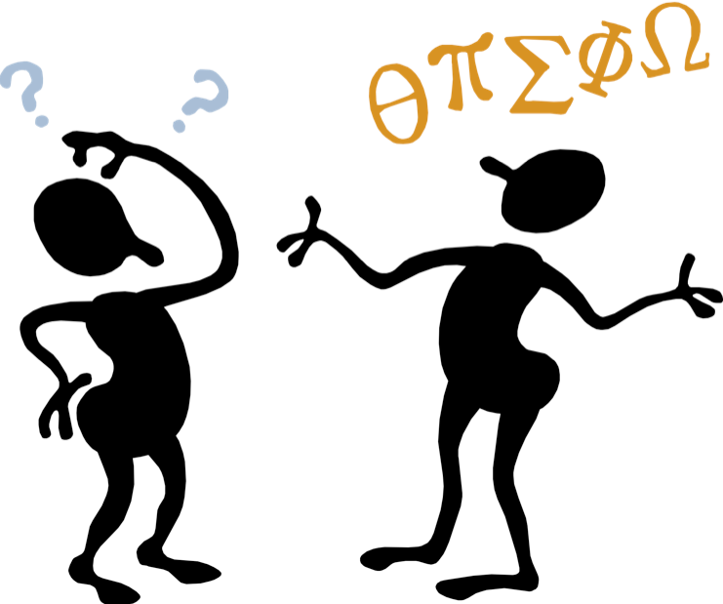
1. Clear communication of tasks/goals.

Slide 50
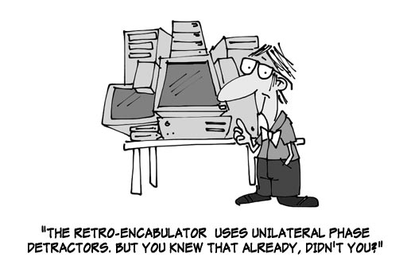
2. Avoid the curse of knowledge.

Slide 51
2. Avoid the curse of knowledge.

Slide 52
3
Great teams make clear and timely decisions and move forward with complete buy-in from every member of the team, even those who voted against the decision. They leave meetings confident that no one on the team is quietly harboring doubts about whether to support the actions agreed on.
Lencioni, p. 207.

Slide 53
3
A team that commits…
Creates clarity around direction and priorities,
Aligns the entire team around common objectives,
Develops an ability to learn from mistakes,
Takes advantage of opportunities,
Moves forward without hesitation,
Changes direction without hesitation or guilt.
Lencioni, p. 209.

Slide 54
3
Focusing on clarity and closure can drive a team toward the kind of commitment that begins to produce ministry results that, in turn, move a [team] toward vision.
Ortberg.

Slide 55
https://www.aictanzania.org/
Our Vision
Ut enim ad minim veniam, quis nostrud exercitation ullamco laboris nisi ut aliquip ex ea commodo consequat.

Slide 56
A traveller came to a fork in the road.
He asked an mzee “Which road do I take?”
“Where do you want to go?” responded the mzee.
“I don’t know.” The traveler answered.
“Then,” said the mzee, “It doesn’t matter.”

Slide 57
Neighbor
A mini

Slide 58
With your neighbour write out the official AICT Vision Statement.
You have two minutes.
A mini Neighbor

Slide 59
Neighbor

Slide 60
1. Ukosefu wa kujitolea umeonekanaje katika huduma yangu au timu yangu?
2. Je kwa njia gani timu yangu inakuza umilikaji katika maumuzi yake.
3. Je kuna mabadiliko gani tufanye ili kujenga zaidi hali ya kujitolea katika huduma yetu au timu?
Neighbor

Slide 61
The Five Disfunctions of a Team
Avoidance of accountability
Clarity and Stability 1 Cor. 3:8
Lack of commitment
Ambiguity
Authenticity
Acts 15:1-7
Artificial
Harmony
Fear of conflict
Vulnerability
2 Cor. 12:9-10
Projection of Invulnerability
Absence of trust

Slide 62
4
"Because of this lack of real commitment and buy-in, team members develop an avoidance of accountability, the fourth disfunction. Without committing to a clear plan of action, even the most focused and driven people often hesitate to call their peers on actions and behaviors that seem counterproductive to the good of the team."
Lencioni, p. 189.

Slide 63
4
So it is not that we necessarily avoid being held accountable—but we avoid holding our team members accountable.

Slide 64
4
Accountability: In the context of teamwork…it refers specifically to the willingness of team members to call their peers on performance or behaviours that might hurt the team.
Lencioni, p. 212.

Slide 65
The Five Disfunctions of a Team
Avoidance of accountability
Low Standards
Clarity and Stability 1 Cor. 3:8
Lack of commitment
Ambiguity
Authenticity
Acts 15:1-7
Artificial
Harmony
Fear of conflict
Vulnerability
2 Cor. 12:9-10
Projection of Invulnerability
Absence of trust

Slide 66
4
“Teams where there is no collective ownership of commitments might do poorly on accountability.”
Tathagat Varma

Slide 67
4
When there is absence of trust, team members often will work towards their individual goals as opposed to team objectives. And often, there will be tendency to just be accountable for one's own piece of work.
Tathagat Varma

Slide 68
Low standards of performance

Slide 69
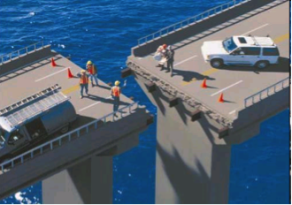
4

Slide 70
The Five Disfunctions of a Team
Courageous
Confrontation
Avoidance of accountability
Low Standards
Clarity and Stability 1 Cor. 3:8
Lack of commitment
Ambiguity
Authenticity
Acts 15:1-7
Artificial
Harmony
Fear of conflict
Vulnerability
2 Cor. 12:9-10
Projection of Invulnerability
Absence of trust

Slide 71
This is not courageous confrontation!
“I’m not good at confrontation, so unscramble this phrase quietly to yourself for a surprise message.”

Slide 72
4
To hold others accountable we must clarify publicly:
Exactly what the team needs to achieve,
Who needs to deliver what,
How everyone must behave in order to succeed.
Lencioni, p. 214.

Slide 73
Accountability
There were four people with a job to do:
Nobody knew that Everybody was not going to do it.
Everybody was sure that Somebody would do it.
Anybody could have done it.
In the end, Nobody did it!
Nobody
Everybody
Somebody
Anybody

Slide 74
4
The Nehemiah principle:
“Vision and purpose must be restated every twenty-six days to keep the church moving in the right direction.”
Rick Warren, The Purpose Driven Church p. 111.

Slide 75
The Five Disfunctions of a Team
Courageous
Confrontation
Gal. 2:11
Avoidance of accountability
Low Standards
Clarity and Stability 1 Cor. 3:8
Lack of commitment
Ambiguity
Authenticity
Acts 15:1-7
Artificial
Harmony
Fear of conflict
Vulnerability
2 Cor. 12:9-10
Projection of Invulnerability
Absence of trust

Slide 76
4
Galatians 2:11,14
¹¹ When Cephas came to Antioch, I opposed him to his face, because he stood condemned...¹⁴ When I saw that they were not acting in line with the truth of the gospel, I said to Cephas in front of them all…

Slide 77
4
“Leadership is about promises, and when we make and keep them—and expect each other to do the same—we live out our leadership with integrity.”
Ortberg.

Slide 78
Neighbor

Slide 79
1. Je ukosefu wa uwajibikaji unaonekanaje katika timu yangu au hudumu yangu.
2. Timu yetu inawasilianaje majukumu, malengo, na wajibu ya wanachama wa timu?
3. Kama kiongozi, au mwanachama wa timu, unawezaje kusaidia kikundi kuwajibika kwa pamoja?
Neighbor

Slide 80
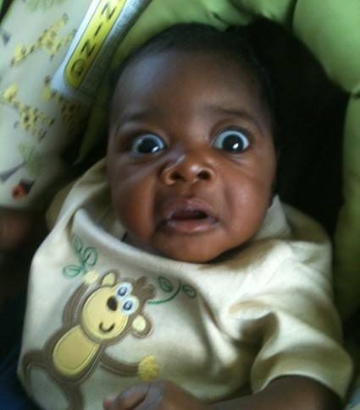
By now, do you feel like this?

Slide 81
Or this?

Slide 82
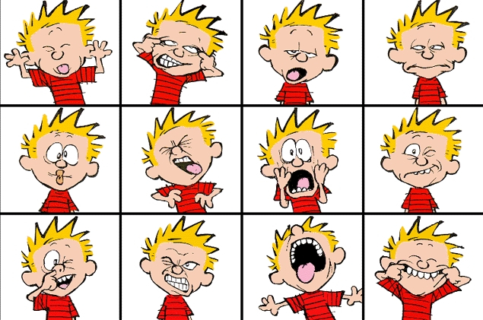
Or maybe this?

Slide 83
The Five Disfunctions of a Team
Inattention
to results
Courageous
Confrontation
Gal. 2:11
Avoidance of accountability
Low Standards
Clarity and Stability 1 Cor. 3:8
Lack of commitment
Ambiguity
Authenticity
Acts 15:1-7
Artificial
Harmony
Fear of conflict
Vulnerability
2 Cor. 12:9-10
Projection of Invulnerability
Absence of trust

Slide 84
5
"Failure to hold one another accountable creates an environment where the fifth disfunction can thrive. Inattention to results occurs when team members put their individual needs (such as ego, career development, or recognition) or even the needs of their divisions above the collective goals of the team."
Lencioni, p. 189.

Slide 85
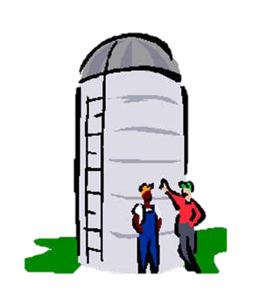
5
This can lead to the Silo Mentality

Slide 86
5
If the team leader and the team members do not hold each other accountable for fulfilling the vision and carrying out the mission of our church they can become so focused on what they want to accomplish, on gaining power or position, that they will not pay attention to results or performing the ministry that God has given to them to do.

Slide 87
The Five Disfunctions of a Team
Inattention
to results
Status and Ego
Courageous
Confrontation
Gal. 2:11
Avoidance of accountability
Low Standards
Clarity and Stability 1 Cor. 3:8
Lack of commitment
Ambiguity
Authenticity
Acts 15:1-7
Artificial
Harmony
Fear of conflict
Vulnerability
2 Cor. 12:9-10
Projection of Invulnerability
Absence of trust

Slide 88
I can’t trust my team members so I must protect myself.
I will not risk conflict but settle for artificial harmony.
For the sake of harmony I will go along but without true commitment
Without commitment, I focus on my own agenda and refuse to hold others accountable.
Thus I focus on my own status and ego needs because…

Slide 89
The Five Disfunctions of a Team
Servanthood
1 Cor. 3:5-9
Inattention
to results
Focus on Status and Ego
Courageous
Confrontation
Gal. 2:11
Avoidance of accountability
Low Standards
Clarity and Stability 1 Cor. 3:8
Lack of commitment
Ambiguity
Authenticity
Acts 15:1-7
Artificial
Harmony
Fear of conflict
Vulnerability
2 Cor. 12:9-10
Projection of Invulnerability
Absence of trust

Slide 90
⁵ What, after all, is Apollos? And what is Paul? Only servants, through whom you came to believe—as the Lord has assigned to each his task. ⁶ I planted the seed, Apollos watered it, but God has been making it grow. ⁷ So neither the one who plants nor the one who waters is anything, but only God, who makes things grow. ⁸ The one who plants and the one who waters have one purpose, and they will each be rewarded according to their own labor. ⁹ For we are co-workers in God’s service; you are God’s field, God’s building.

Slide 91
Some practical thoughts on how to help teams focus on results.
5

Slide 92
1. Follow through by the team leader.
5

Slide 93
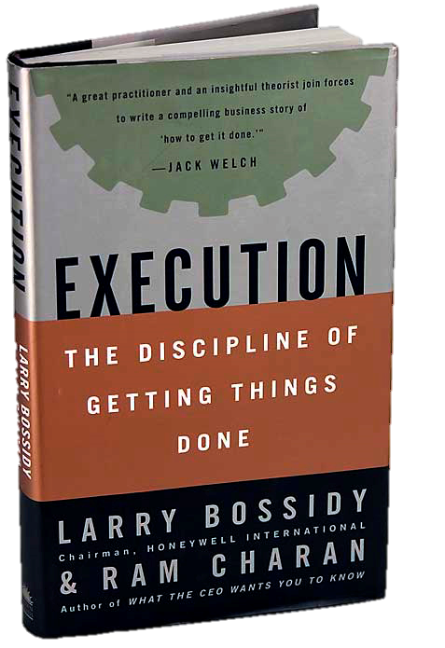
“Follow-through is the cornerstone of execution, and every leader who’s good at executing follows through religiously. Following through ensures that people
are doing the things
they committed to do.”
Execution: The Discipline of Getting Things Done
by Larry Bossidy, Ram Charan

Slide 94
2. Find a way to encourage positive peer pressure on the team.
5

Slide 95
5
When accountability only exists between each team member and their boss, its effect is limited. But, when team members feel accountable to each other, their performance shifts from being professional to being personally important…

Slide 96
5
People will work hard to avoid disappointing their boss, but they will work harder to avoid disappointing their team. The result is a dramatically increased level of performance and follow through.

Slide 97
3. Find a visual way to track progress toward the goal or to “keep score.”
5

Slide 98
April
May
June
July
August
Sept.
Oct.
Tasks
John
Materials
Mary
Finances
Goal
James
Deadline
Publicity
Peter
Personnel
Beatrice
P & P Development

Slide 99
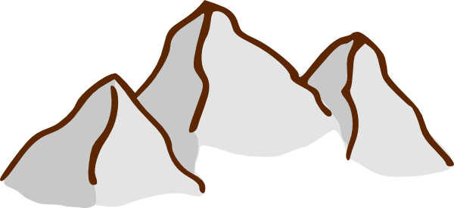
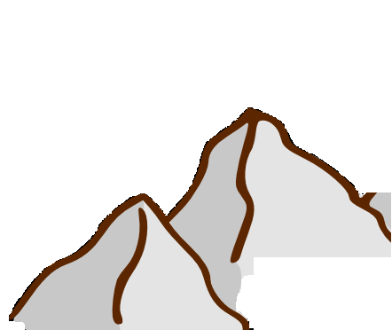
April
May
June
July
August
Sept.
Oct.
Goal
Task 4
Deadline
Task 3
Task 2
Task 1

Slide 100
4. Find a way to provide incentive or reward for reaching goals or milestones.
5

Slide 101
5. Celebrate victories as a team.
5

Slide 102
Neighbor

Slide 103
How is inattention to results seen in my ministry or team?
The presenter said the way to address this is through servanthood. How can team leaders and members practice serving each other and the team to accomplish the overall mission?
Neighbor

Slide 104
1. Je kwa njia gani ukosefu wa matarajio ya matokeo unaonakanaje kwenye timu au huduma yangu.
2. Mwezeshaji alisema njia moja ya kutatua hali hii ya upungufu wa matokeo ni kusisitiza uongozi aina ya utumishi, ‘Servanthood’. Je, viongozi wa timu na wajumbe wangeaweza kufanya nini ili kuhudumiana ili kukamilisha na kutimiza makusudi ya timu.
Neighbor

Slide 105
The Role of Team Leader
Inattention
to results
Avoidance of accountability
Lack of commitment
Fear of conflict
Go First!
Absence of trust

Slide 106
R
Going First is Modeling!
Can you think of biblical examples?

Slide 107
Jesus and Paul!
R
Paul says, “Follow my example, as I follow
the example of Christ.”
1 Corinthians 11:1

Slide 108
Going first in vulnerability will set the tone.
R

Slide 109
The Role of Team Leader
Inattention
to results
Avoidance of accountability
Lack of commitment
Mine for Conflict
Fear of conflict
Go First!
Absence of trust

Slide 110
R
How do we mine or dig for conflict?
Ask “is there another way to look at this?”
Play the “devil’s advocate.”

Slide 111
The Role of Team Leader
Inattention
to results
Avoidance of accountability
Lack of commitment
Force Clarity and Closure
Mine for Conflict
Fear of conflict
Go First!
Absence of trust

Slide 112
R
How do we force clarity and closure?
Ask each team member to state their task.
Write it down.
Follow it through with personal reminders.
Don’t assume anything!

Slide 113
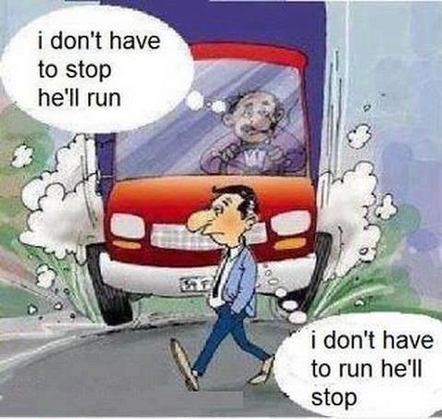
R

Slide 114
The Role of Team Leader
Inattention
to results
Avoidance of accountability
Confront Difficult Issues
Lack of commitment
Force Clarity and Closure
Mine for Conflict
Fear of conflict
Go First!
Absence of trust

Slide 115
R
How do we confront difficult issues?
Through Prayer
Humbly
Patiently
Courageously
Culturally sensitive
Right timing/place

Slide 116
The Role of Team Leader
Focus on Collective Outcomes
Inattention
to results
Avoidance of accountability
Confront Difficult Issues
Lack of commitment
Force Clarity and Closure
Mine for Conflict
Fear of conflict
Go First!
Absence of trust

Slide 117
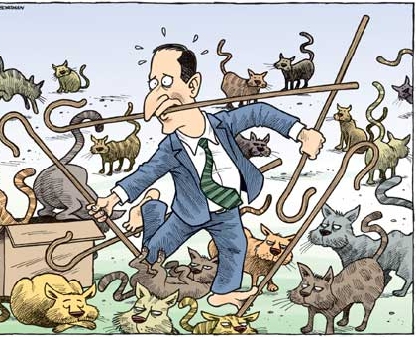
Sometimes being a team leader is like herding cats!
R

Slide 118
R
How do we focus on collective outcomes?
Be the vision bearer.
Be focused yourself.
Be the voice of discipline.

Slide 119
Growing Teams:
Focus
on results
Achieve together
Be
accountable
Set high standards
Set clear
goals
Commit!
Nurture Discussions
Create true harmony
Be Vulnerable, be open
Trust

Slide 120
A well functioning team!

